Slide 1
Traffic Simulator 1.0
Team Members:
Max Leone, Humberto Chacon, Salvador Gandara
Product Owner: Kianoosh G. Boroojeni
Instructor: Masoud Sadjadi School of Computing and Information Sciences Florida International University
Final Presentation
Spring 2017
The logo of your project
Notes:
7 seconds.( I will select 2 best slides (i will give them extra points and students will present for CIS committee)
Greet your audience, thank them for attending your presentation, introduce yourself, introduce your project, introduce your team members, and quickly indicate what each of you did in a high-level manner, and put more emphasis on your part/contribution.

Slide 2
Project definition
Provide a service for routing driverless vehicles.
Routing is done through oblivious routing algorithms due to oblivious and/or highly stochastic traffic patterns.
Provide a simulator to test and visualize algorithms
Provide an API for calling the algorithms that have been implemented
Notes:
10 seconds.
Introduce the problem that the whole project (in all versions) tackles with GIF or screenshot.

Slide 3
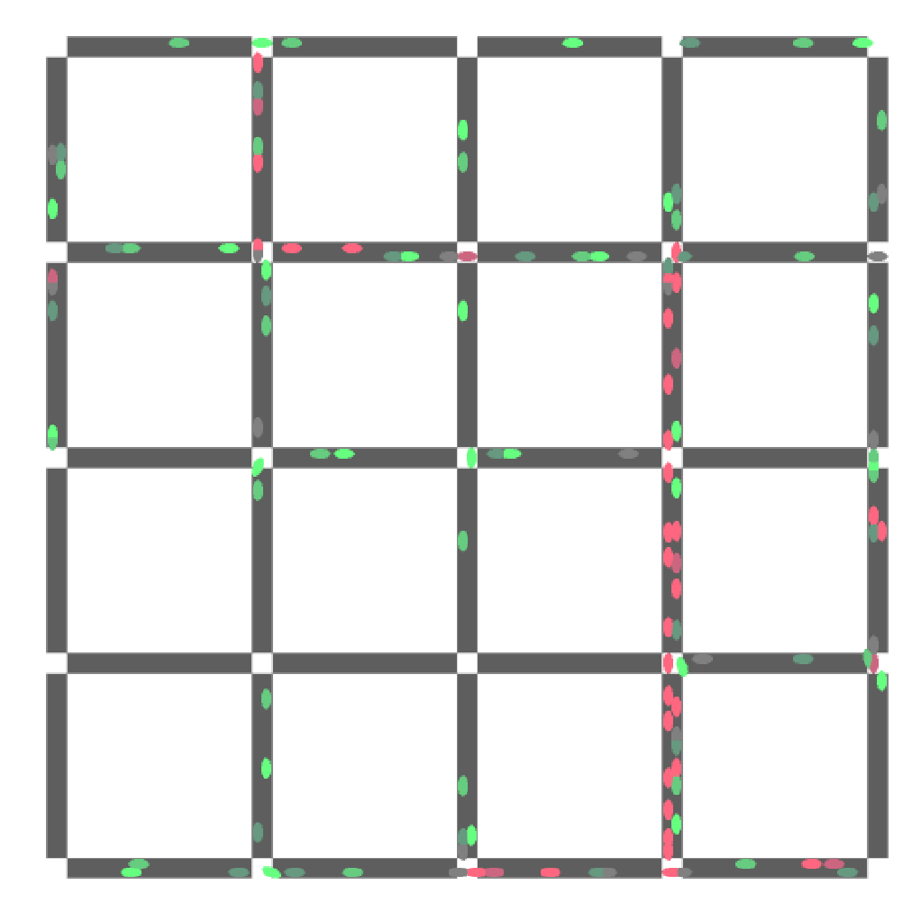
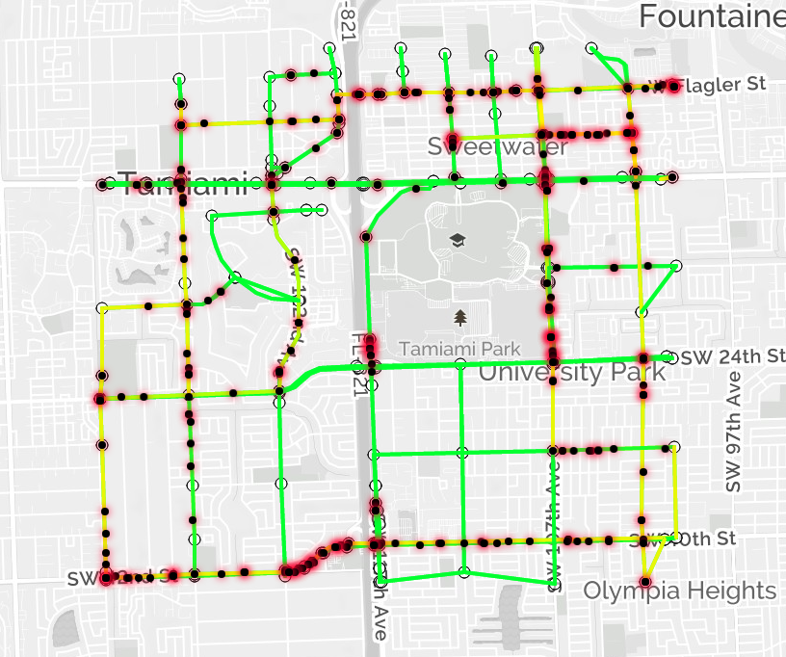
Project definition
Notes:
20 seconds.
Introduce the problem that the your project (in new version) tackles with GIF or screenshot.

Slide 4
Requirements: Use Cases
Notes:
5 seconds
Show the Use Case Diagram for the whole project. Highlight your use cases.

Slide 5
System Design: Architecture
Notes:
20 seconds
System design: Highlight the parts that you contributed to them.
1. System decomposition; identify the architecture patterns used
2. System deployment – h/w and s/w requirements

Slide 6
Minimal Class Diagram
Notes:
10 seconds.Minimal class diagram. Highlight the classes that you created/modified
Identify the design patterns used (one or more slides).

Slide 7
User Stories
1.
2.
3. Implement Authorization for Flask API
4. Create Dev Endpoints to Simplify Testing
5. Randomized HDS Generation
6. Top-Down Integral Routing Scheme
Notes:
5 seconds.
List the user stories that you worked on them.(put in order of importance). Stay focused on the parts that you have been working.

Slide 8
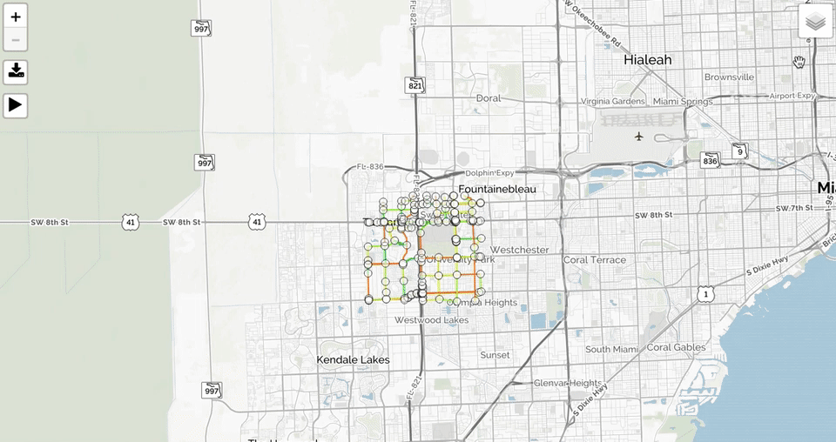
User Story #1
Display Leaflet Map
As a user I would like to be able to see a map similar to google maps in order to better visualize the traffic simulation.
Notes:
60 seconds
The tile of user story
The most important user story you worked on it. You have to describe this one very well and be proud of that.
Please present and show the complexity of your work, code, algorithms, and technical challenges and technologies you have used. (you could use screenshot if you want. Visual presentations are better than text presentation)
Go into the details of the most important/significant tasks using bullet lists or visual graphs or state chart diagram
Sequence Diagram for this user story is mandatory (in another separate page if required)
Demo using screenshots or GIF (in another separate page if required)

Slide 9
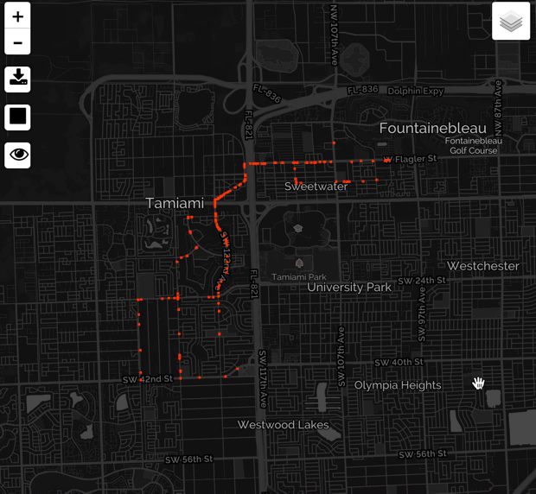
User Story #2
Run Simulation
As a user I would like to be able to run the traffic simulation and see the results of the routing API in the form of simulated vehicles following the paths returned by the API on the map.
Notes:
20 seconds
The tile of user story
Please present and show the complexity of your work, code, algorithms, and technical challenges and technologies you have used. (you could use screenshot if you want. Visual presentations are better than text presentation) - Go into the details of the most important/significant tasks using bullet lists or visual graphs or state chart diagram - Demo using screenshots or GIF (in another separate page if required)
Sequence Diagram for this user story is optional

Slide 10
User Story #3
Implement Authorization for Flask API
To be able to sell access to our API, we must have the ability to determine the identity of the user calling an endpoint and how many times they have accessed the API in a certain time frame.
Notes:
20 seconds
The tile of user story
Please present and show the complexity of your work, code, algorithms, and technical challenges and technologies you have used. (you could use screenshot if you want. Visual presentations are better than text presentation) - Go into the details of the most important/significant tasks using bullet lists or visual graphs or state chart diagram - Demo using screenshots or GIF (in another separate page if required)
Sequence Diagram for this user story is optional

Slide 11
User Story #4
Make Dev Endpoints to Simplify Testing
After the implementation of key authentication and endpoint limiting, developers need dev endpoints that are not subject to any restrictions to be able to test new features easier.
Notes:
20 seconds
The tile of user story
Please present and show the complexity of your work, code, algorithms, and technical challenges and technologies you have used. (you could use screenshot if you want. Visual presentations are better than text presentation) - Go into the details of the most important/significant tasks using bullet lists or visual graphs or state chart diagram - Demo using screenshots or GIF (in another separate page if required)
Sequence Diagram for this user story is optional

Slide 12
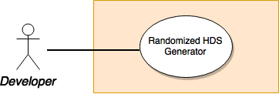
User Story #5 - Randomized HDS Generation
As a developer I would like to generate Hierarchical Decomposition Sequence’s (HDS) based off of a given graph with power of 2 diameter so that I can then generate Hierarchical Decomposition Trees (HDT) which are used when generating routing schemes.
Notes:
20 seconds
The tile of user story
Please present and show the complexity of your work, code, algorithms, and technical challenges and technologies you have used. (you could use screenshot if you want. Visual presentations are better than text presentation) - Go into the details of the most important/significant tasks using bullet lists or visual graphs or state chart diagram - Demo using screenshots or GIF (in another separate page if required)
Sequence Diagram for this user story is optional

Slide 13
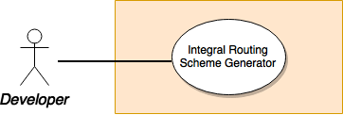
User Story #6 - Top-Down Integral Routing Scheme
As a developer I would like to generate a routing scheme based on paths generated from HDT’s.
Notes:
20 seconds
The tile of user story
Please present and show the complexity of your work, code, algorithms, and technical challenges and technologies you have used. (you could use screenshot if you want. Visual presentations are better than text presentation) - Go into the details of the most important/significant tasks using bullet lists or visual graphs or state chart diagram - Demo using screenshots or GIF (in another separate page if required)
Sequence Diagram for this user story is optional

Slide 14
Test Suites and Test Cases
Traffic Sim Matrix Test functions (whitebox)
Python cmd line nx and np testing (greybox)
Run traffic sim + API on localhost (blackbox)
Notes:
10 seconds
A description of verification process and Test Suites and Test Cases for one of the use cases.
1 One sunny day and one rainy day for the implemented use cases (one or more slides).
2 Automated test scripts for the implemented use cases (if any) (one or more slides).

Slide 15







Summary
Summary
contact information
Questions?
Thank You!
Notes:
10 seconds
Summarize your contribution, mention your effort for Scrum, Mingle, Github, Google Drive Documentation and minutes
Include your contact information
Ask if anyone has any questions for you.
Thank your audience

